Slide 1
Section 2: Medical Gases
Chapter 4
Administering Medical Gases: Regulators, Flowmeters, and Controlling Devices

Slide 2
Chapter Outline
Regulators and Flowmeters
Devices for Administering Medical Gases

Slide 3
Objective
Upon completion of this chapter, you will be able to
  compare the design and operation of single-stage and multistage regulators.
  identify the components of preset and adjustable regulators.
  explain the operational theory of a Thorpe tube flowmeter, a Bourdon flowmeter, and a flow restrictor.
  demonstrate a method for determining whether a flowmeter is pressure compensated.

Slide 4
Objective (Cont.)
  compare low-flow and high-flow oxygen delivery systems.
  name several commonly used low-flow oxygen delivery systems.
  describe the components of a high-flow nasal cannula system and the benefits of using these systems in the treatment of hypoxemia.
  discuss the advantages and disadvantages of using oxygen-conserving devices in the treatment of patients requiring long-term oxygen therapy.

Slide 5
Objective (Cont.)
  explain the operational theory of air entrainment devices.
  compare the operation of oxygen blenders with that of oxygen mixers and adders.
  describe the physiologic effects of hyperbaric oxygen therapy.
  list the indications and contraindications of inhaled nitric oxide therapy.
  describe the appropriate use of mixed gas (e.g., heliox, carbogen) therapy.

Slide 6
Regulators and Flowmeters
Devices that reduce high-pressure gases from cylinders or bulk storage units to lower working pressures
  Single-stage
  Multistage
  Further divided into preset and adjustable regulators
Flowmeters are devices that control and indicate the gas flow delivered to patients
  Thorpe tube flowmeters
  Bourdon flowmeters
  Flow restrictors

Slide 7
Regulators
Single-stage regulators
  Consists of a body that is divided in half by a flexible metal diaphragm.
  Area above the diaphragm is a high-pressure chamber.
  Lower chamber has a spring attached to the lower surface of the diaphragm and is exposed to ambient pressure.
  Excess pressures in the upper chamber can be released through a pressure relief valve.

Slide 8
Regulators (Cont.)
Gas flow into the high-pressure side of the regulator depends on the effects of two opposing forces
  Gas pressure above the diaphragm
  Spring tension below the diaphragm
For a preset single-stage regulator
  The spring tension is calibrated to deliver gas at a preset pressure (usually 50 psig).

Slide 9
Regulators (Cont.)
For single-stage adjustable regulators
  The operator adjusts the spring tension (and thus control the outlet pressure) by using a threaded hand control attached to the spring-diaphragm apparatus.
  Most adjustable regulators can be set to deliver pressures between 0 and 100 psig.

Slide 10
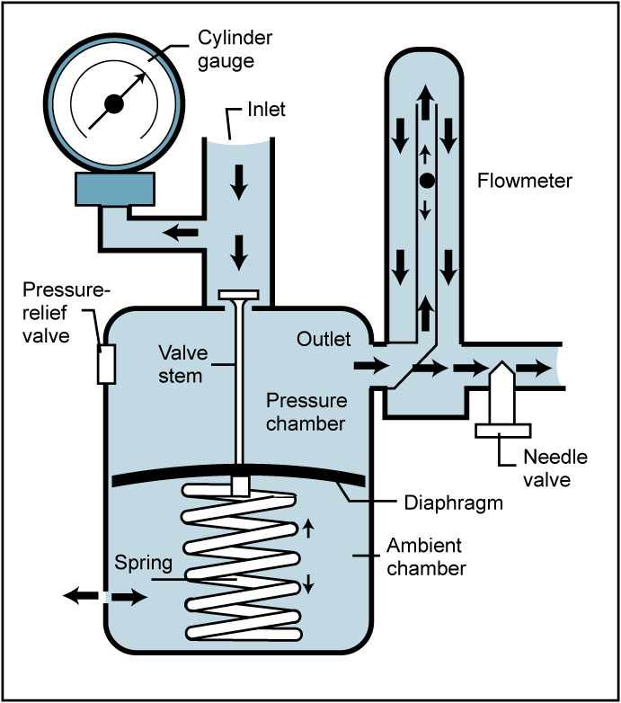
Regulators (Cont.)
Single stage
  Pressure is reduced from 2200 to 50 psi in single step.

Slide 11
Regulators (Cont.)
Multistage regulators
  Two or more single-stage regulators in a series
  The tension of the spring in the first stage of the regulator is usually preset by the manufacturer
  The spring tension in the second stage typically is adjustable
  Each stage of the regulator contains a pressure relief valve

Slide 12
Regulators (Cont.)
  Multistage regulators
    Can control gas pressures with more precision than single-stage regulators because the pressure is reduced gradually.
    Multistage regulators produce gas flow that is much smoother than that from single-stage regulators.
    Reserved for tasks requiring precise gas flow

Slide 13
Regulators (Cont.)
Multistage regulators
  Pressure is reduced from 2200 to 50 psi in steps (2200 to 700 psi to 50 psi)

Slide 14
Thorpe Tube Flowmeter
Consists of
  a tapered, hollow tube engraved with a calibrated scale (usually in L/min)
    Flowmeters used in neonatal and pediatric care may be calibrated in mL/min
  a float
  a needle valve for controlling the flow rate of gas

Slide 15
Thorpe Tube Flowmeter (Cont.)
As gas flows through the unit, it pushes the float higher
As the ball float moves higher in the Thorpe tube, more gas is allowed to travel around it
  Results of the gradually increasing diameter of the indicator tube

Slide 16
Thorpe Tube Flowmeter (Cont.)
Pressure compensated
  The needle valve controlling gas flow out of the flowmeter is located downstream of the Thorpe tube.
  This allows the pressure in the indicator tube to be maintained at the source gas pressure.
  Provide accurate estimates of flow, regardless of the downstream pressure.

Slide 17
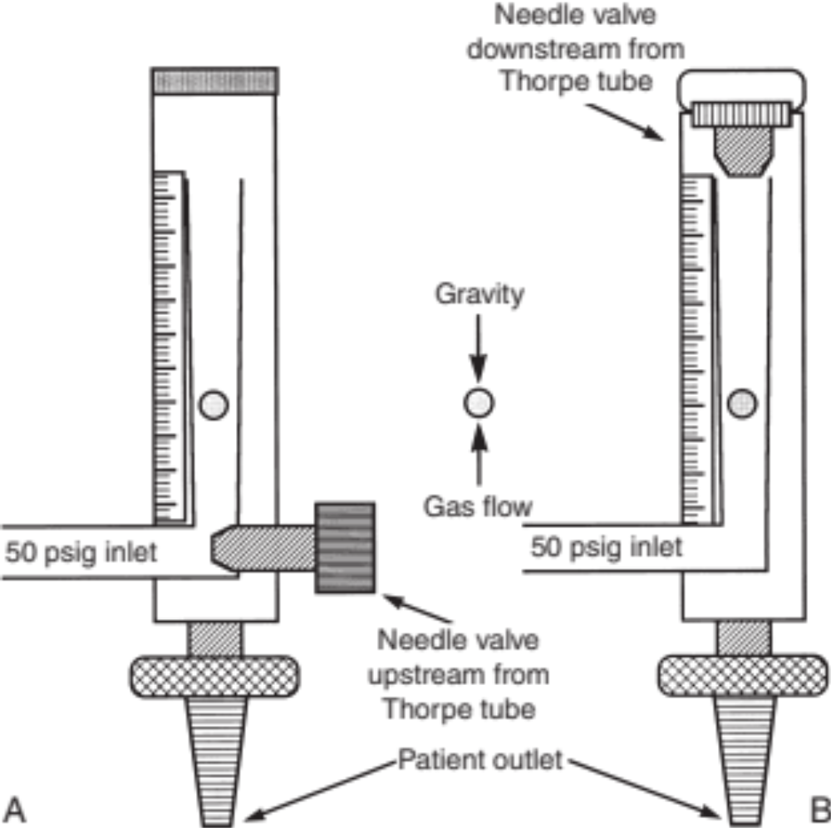
Thorpe Tube Flowmeter (Cont.)

Slide 18
Thorpe Tube Flowmeter (Cont.)
Non–pressure compensated
  The needle valve is located before the indicator tube.
  Restriction or high-resistance devices attached to the outlet of a non–pressure-compensated Thorpe tube flowmeter create back pressure, which is transmitted back to the needle valve.
    Because the needle valve is located proximal to the Thorpe tube, the back pressure causes the float to fall to a level that indicates a flow lower than the actual flow.

Slide 19
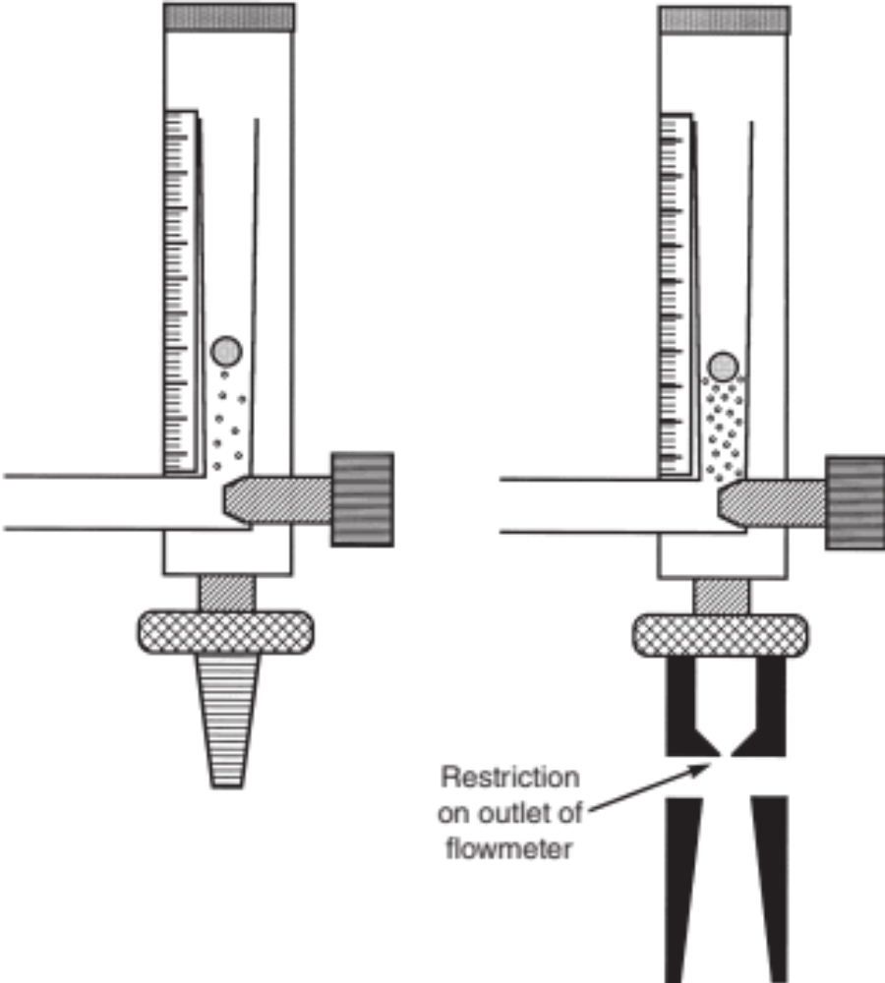
Thorpe Tube Flowmeter (Cont.)

Slide 20
Bourdon Flowmeter
Actually a reducing valve that controls the pressure gradient across an outlet with a fixed orifice
Regulates pressure to control flow
  As the driving pressure is increased, the flow from the flowmeter outlet increases
Flow calibrated in liters per minute

Slide 21
Bourdon Flowmeter (Cont.)
As long as the pressure distal to (i.e., downstream from) the orifice remains atmospheric, the indicated flow is accurate.
Uncompensated
  As resistance to flow increases, the indicated flow reading becomes inaccurate
  Back pressure will cause indicated flow to increase and actual flow will decrease
Can be used in any position; not affected by gravity

Slide 22
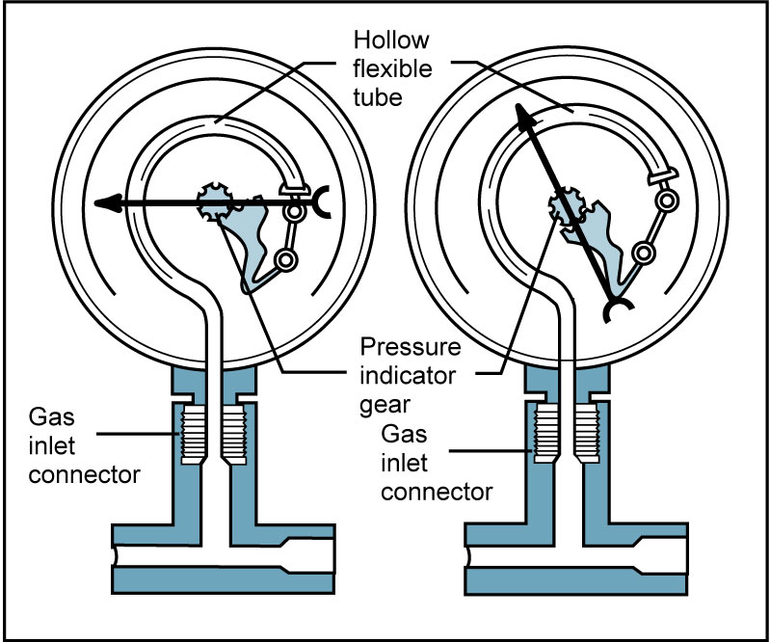
Bourdon Flowmeter (Cont.)

Slide 23
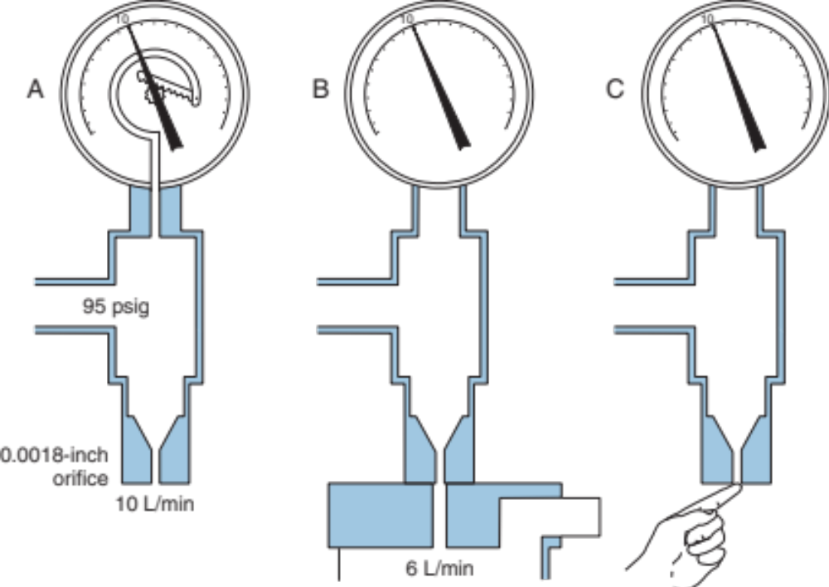
Bourdon Flowmeter (Cont.)
Notes:
Fig. 4.8 shows how increasing resistance at the gas outlet affects the flow reading. Note that although the outlet becomes totally occluded, the flow reading remains constant.

Slide 24
Flow Restrictors
Gas passes through an orifice; this allows fixed amount of gas to flow through the orifice
Two types of flow restrictors
  Fixed orifice—only one flow rate will be provided
  Adjustable orifice—has several orifices providing several options for flow
Essential to use the appropriate operating pressure

Slide 25
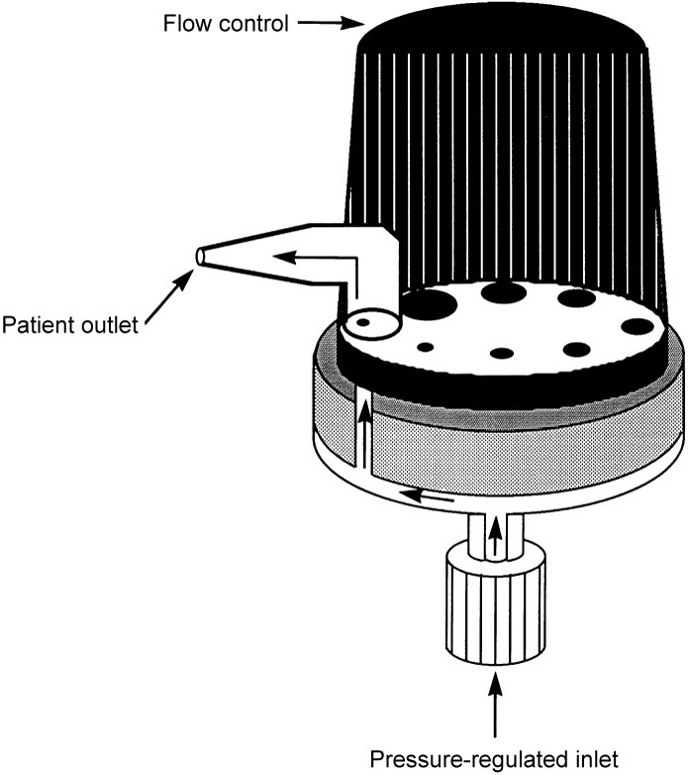
Flow Restrictors (Cont.)
Variable orifice flow restrictor

Slide 26
Oxygen Therapy
The goal of oxygen therapy is to treat or prevent hypoxemia
Respiratory therapists must
  understand how to select and assemble devices.
  ensure that they are working properly.
Clinical practice guidelines
  Inform practitioners of indications, contraindications, precautions, and possible complications of oxygen therapy.

Slide 27
Clinical Practice Guideline: Oxygen Therapy in the Acute Care Facility
Indications
  Documented hypoxemia
  Suspected hypoxemia
  Severe trauma
  Acute myocardial infarction
  Short-term therapy

Slide 28
Clinical Practice Guideline: Oxygen Therapy in the Acute Care Facility (Cont.)
Precautions and/or complications
  Suppression of ventilatory drive
  Adsorption atelectasis
  Bacterial contamination
  Use with caution in patients with paraquat poisoning or those receiving bleomycin
  Use low levels in patients receiving laser bronchoscopy

Slide 29
Clinical Practice Guideline: Oxygen Therapy in the Acute Care Facility (Cont.)
Limitations
  Oxygen therapy has limited effectiveness in patients with anemia and circulatory impairment.
  Oxygen therapy should not be used as substitute for mechanical ventilation.

Slide 30
Clinical Practice Guideline: Oxygen Therapy in the Acute Care Facility (Cont.)
Monitoring
  Should be monitored with clinical assessment and Pao₂ or Spo₂
  Should be monitored periodically
    Initiation of therapy
    Within 12 hour of start of therapy (F_{i}o₂ levels <0.40)
    Within 8 hour of start of therapy (F_{i}o₂ levels >0.40)
    Within 72 hour of an acute myocardial infarction
    Within 2 hour of a diagnosis of chronic obstructive pulmonary disease (COPD)

Slide 31
Clinical Practice Guideline: Oxygen Therapy in Home or Alternative Care Site
Settings
  In home
  In an alternative care site (skilled nursing facility or extended care facility)

Slide 32
Clinical Practice Guideline: Oxygen Therapy in Home or Alternative Care Site (Cont.)
Indications
  Documented hypoxemia
    Pao₂ equal to or less than 55 torr when breathing room air.
    Spo₂ equal to or less than 88% when breathing room air.
    Exceptions: a diagnosis of cor pulmonale, congestive heart failure, or hematocrit >56% allows for higher oxygen levels.

Slide 33
Clinical Practice Guideline: Oxygen Therapy in Home or Alternative Care Site (Cont.)
Precautions—same as guideline for acute care hospital
Resources
  Low-flow devices: nasal cannulas, transtracheal catheters, pulse delivery devices, reservoir nasal cannula
  High-flow devices: tracheostomy collars and T tubes
  Supply systems: concentrator, liquid system, or compressed gas cylinder

Slide 34
Clinical Practice Guideline: Oxygen Therapy in Home or Alternative Care Site (Cont.)
Monitoring
  Monitor Spo₂ or Pao₂ before starting therapy.
  Repeat measurement when it is indicated.
Infection control
  Low risk of infection when humidifier is not used
  Equipment should be cleaned and disinfected on a regular basis.

Slide 35
Clinical Practice Guideline: Selection of Oxygen Delivery Device for Neonatal and Pediatric Patients
Definition/description
  Administration of oxygen to a neonatal or pediatric patient
Indications
  Documented hypoxemia
  Suspected hypoxemia

Slide 36
Clinical Practice Guideline: Selection of Oxygen Delivery Device for Neonatal and Pediatric Patients (Cont.)
Contraindications
  Nasal cannulas and catheters are not appropriate for patients with nasal obstruction.
  Catheters are not appropriate for patients with facial trauma.
  Catheters are not appropriate for neonatal patients.

Slide 37
Clinical Practice Guideline: Selection of Oxygen Delivery Device for Neonatal and Pediatric Patients (Cont.)
Hazards/precautions/possible complications
  ROP—keep Pao₂ < 80 torr
  Avoid high oxygen levels with some types of congenital heart disease
  Avoid oxygen therapy in patients being treated for paraquat poisoning or those receiving bleomycin
  Changes in ventilatory pattern from cool gas directed at infant’s face
  Skin irritation
  Gastric distention
  Increased risk of aspiration with masks

Slide 38
Oxygen Therapy
Oxygen Conservation Devices
  Transtracheal catheters
    Lower flow rates since oxygen is delivered directly into the trachea
    Risks include infection and obstruction
    Require frequent care to prevent complications

Slide 39
Oxygen Therapy (Cont.)
Low flow (variable performance)
  Delivers an F_{i}o₂ of 0.22 to 0.80
  F_{i}o₂ is affected by inspiratory flow rate, tidal volume, respiratory rate, and flow rate of oxygen
  Low-flow devices include
    nasal cannula
    transtracheal catheters
    simple mask
    partial rebreather
    nonrebreather

Slide 40
Oxygen Therapy (Cont.)
High flow (fixed performance)
  Provides flow rate adequate to meet patients’ inspiratory flow needs
  Delivers a fixed F_{i}o₂ of 0.24 to 1.0
    Regardless of the patient's breathing pattern
  Examples include
    air entrainment mask
    high-flow nasal cannulas
    Incubators
    oxygen tents
    oxygen hoods

Slide 41
Low Flow Nasal Cannula
Used to deliver low-flow oxygen therapy
through nares
Available in infant, child, and adult sizes
Delivers a F_{i}o₂ of 0.24 to 0.44
  Oxygen flow rates of 1 to 6 L/min
  0.25 to 2 L/min for neonates
Delivered F_{i}o₂ affected by
  respiratory rate
  tidal volume
  oxygen flow rate

Slide 42
Low Flow Nasal Cannula (Cont.)
Approximate F_{i}o₂
  1 L/min—0.24
  2 L/min—0.28
  3 L/min—0.32
  4 L/min—0.36
  5 L/min—0.40
  6 L/min—0.44

Slide 43
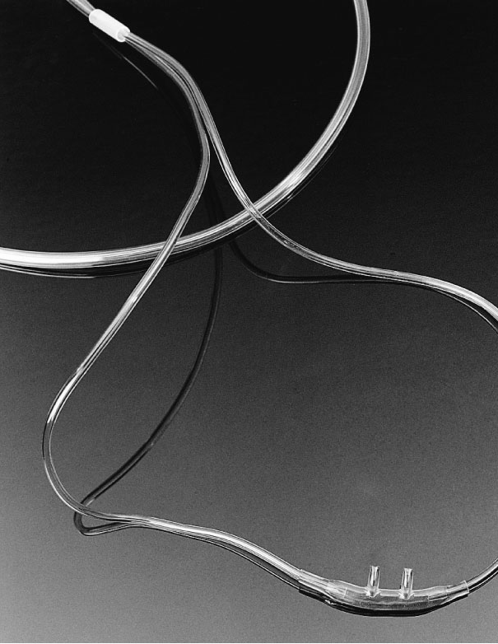
Low Flow Nasal Cannula (Cont.)
Common problems
  Nasopharyngeal-mucosal irritation
  Twisting of connective tubing
  Skin irritation

Slide 44
Oxygen-Conserving Devices
Transtracheal oxygen (TTO) catheters
Reservoir cannulas
Pulse-demand oxygen delivery systems

Slide 45
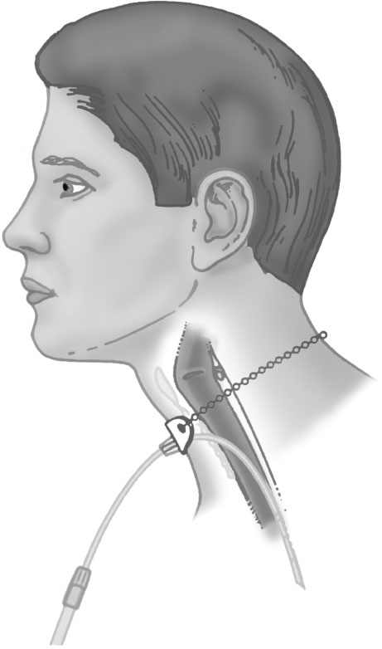
Transtracheal Oxygen Catheter
Oxygen delivered directly into the trachea
Can produce overall oxygen savings of 54% to 59%
Placement requires minor surgery
Routine care should include cleaning, lavage, and use of a cleaning rod to remove mucus
Notes:
A small, plastic stent is inserted into the patient's trachea between the second and third tracheal rings. The stent remains in place for about a week to ensure that a permanent tract is formed between the trachea and the outer skin. Removal of the stent is accomplished over a guide wire. After the stent is removed, a 9-Fr Teflon catheter is inserted into the tract over the guide wire. The catheter is held in place with a neck chain to prevent inadvertent dislodgment or removal. It is recommended that catheters are replaced at 90 days or sooner, before they become cracked, kinked, or occluded by pus or mucus. Patients must be taught the proper care of these devices to prevent complications.

Slide 46
Oxygen Conservation Devices
Reservoir nasal cannula
  Available in mustache cannula or pendent cannula
  Reservoir traps oxygen-rich gas from early portion of exhalation
  Oxygen is inspired with next breath
  Decreases flow rate of oxygen necessary to obtain required Spo₂

Slide 47
Reservoir Nasal Cannula
Two commercially available reservoir cannulas
  Mustache cannula
    Can hold about 20 mL of 100% oxygen
  Pendant cannula
    Can hold nearly 40 mL of 100% oxygen

Slide 48
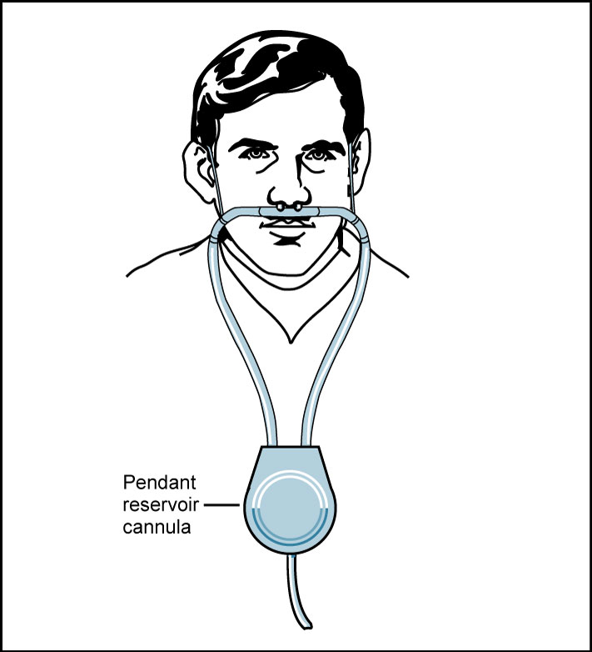
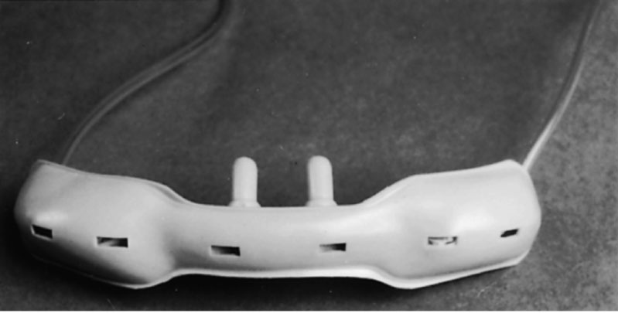
Reservoir Nasal Cannula (Cont.)

Slide 49
Pulse Demand Oxygen Delivery System
Delivers oxygen only during inspiration
Can be used with nasal cannulas, nasal catheters, and TTO catheters
Delivers flows equivalent to 1 to 5 L/min
Demand valve connects directly to the oxygen source (50 psig)
  Replaces the flowmeter used with continuous flow cannula
Can function as pulsed or continuous flow sources of oxygen

Slide 50
Pulse Demand Oxygen
Delivery System (Cont.)

Slide 51
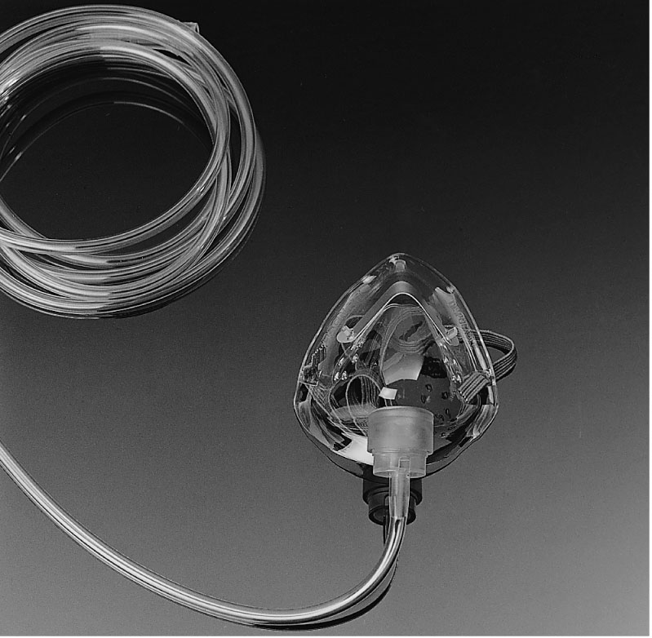
Simple Oxygen Mask
During inspiration, patient draws air from
  Tubing
  reservoir in the mask
  ports in side of the mask
Delivers F_{i}o₂ of 0.35 to 0.50 at flows of 5 to 10 L/min

Slide 52
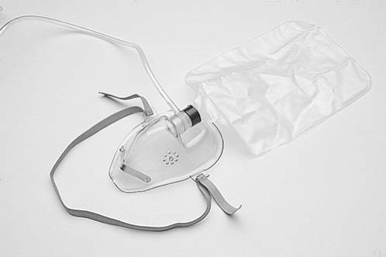
Partial Rebreathing Mask
Includes reservoir bag, but there are no values
Delivers F_{i}o₂ of 0.40 to 0.60 at flows of 6 to 8 L/min
Bag must be one-third to one-half full during inspiration
Notes:
In a typical adult partial rebreathing mask, the reservoir bag has a volume capacity of about 300 to 500 mL.

Slide 53
Nonrebreathing Mask
Looks very similar to partial rebreathing masks except that
  they have two types of valves attached to the mask.
Valve allows patient to pull oxygen from reservoir during inspiration
Same valve prevents patient from exhaling back into reservoir
Valve over exhalation ports on side of mask prevents air from being entrained during inspiration

Slide 54
Nonrebreathing Mask (Cont.)
Delivers an F_{i}o₂ of 0.60 to 0.80
Flow rates must be adequate to prevent excessive deflation during inspiration

Slide 55
Air Entrainment Mask
Consists of a plastic mask connected to a jet nozzle, which is encased within a plastic housing that contains air entrainment ports.
Oxygen and air mixes to obtain precise concentration
  Flow of oxygen to the nozzle is constant and set to a minimum value, usually 2 to 10 L/min.
Primary application: to provide oxygen therapy for patients with COPD

Slide 56
Air Entrainment Mask (Cont.)

Slide 57
Air:Oxygen Ratios
F_{I}O₂ | Air:oxygen ratio | Total parts
0.24 | 25:1 | 26
0.28 | 10:1 | 11
0.30 | 8:1 | 9
0.35 | 5:1 | 6
0.40 | 3:1 | 4

Slide 58
High-Flow Nasal Cannulas
High-flow nasal cannula (HFNC) systems
  Can achieve high F_{I}O₂ levels by washing out CO₂ from the nasopharyngeal dead space and generating gas flows that exceed the inspiratory flow needs of most patients.
  Include a patient interface, a gas delivery device to control oxygen flow, and a humidifier.

Slide 59
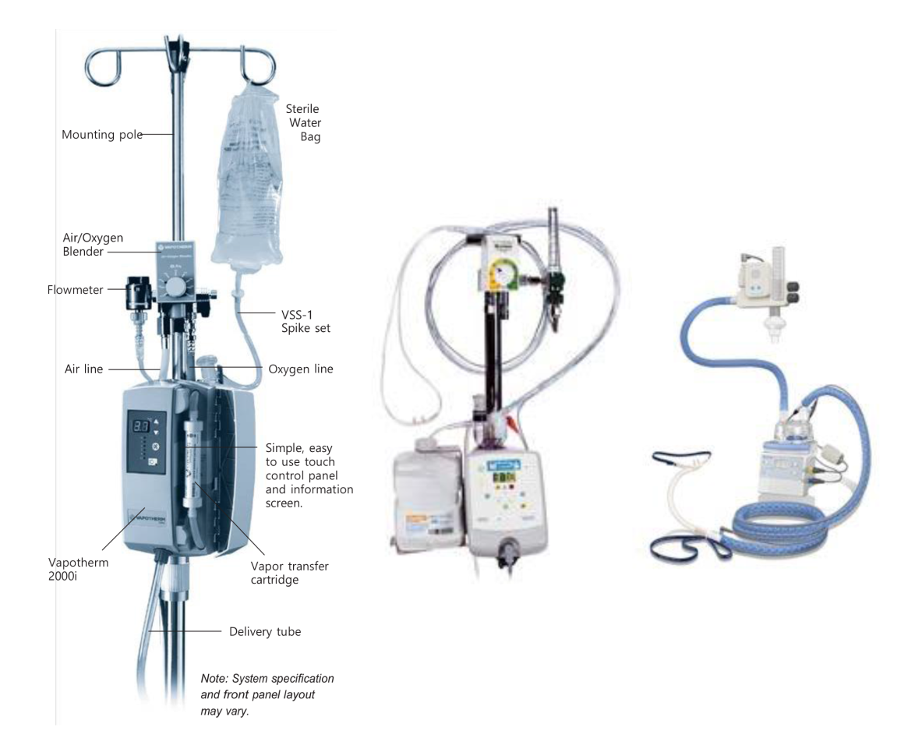
High-Flow Nasal Cannulas (Cont.)

Slide 60
Oxygen Hoods
Used to deliver supplemental oxygen to infants
  Maintaining a relatively constant F_{I}O₂
The F_{i}o₂ should be monitored at same level as infant’s nose
Noise levels inside hood can be problematic

Slide 61
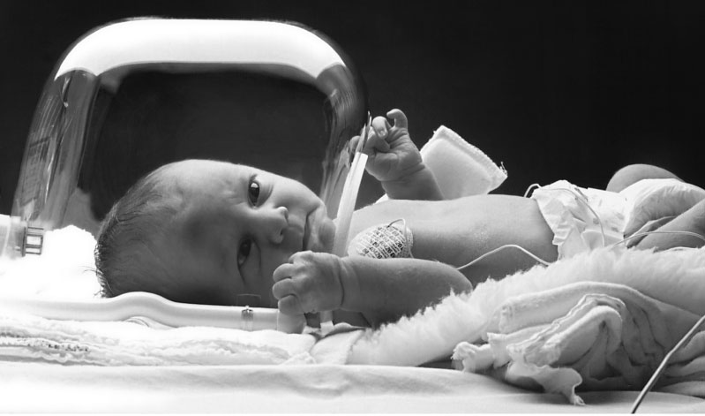
Oxygen Hoods (Cont.)

Slide 62
Incubators
Regulate temperature, humidity, and F_{i}o₂ of infants’ environment
Include port to regulate F_{i}o₂
  if port is open, F_{i}o₂ is 0.40 or less
  if port is closed, F_{i}o₂ is 0.40 or higher
F_{i}o₂ inside incubator can vary significantly due to opening chamber for nursing care
Hood inside incubator may be necessary to maintain consistent F_{i}o₂

Slide 63
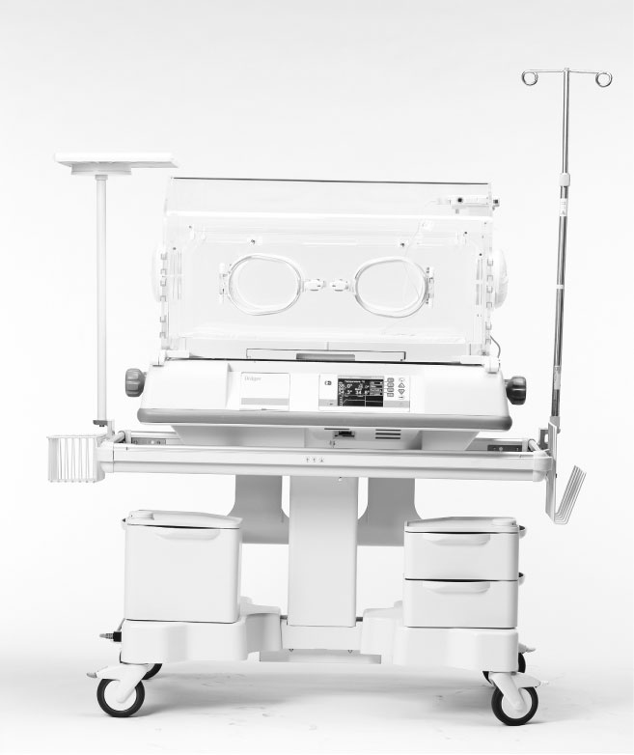
Incubators (Cont.)

Slide 64
Oxygen Tents
Oxygen tents are used primarily for pediatric patients who require enriched oxygen and high humidity levels.
Can provide environmental control of
  oxygen concentration.
  humidity.
  temperature.
F_{I}O₂ and the humidity content delivered to the patient are controlled by a high-flow aerosol unit.

Slide 65
Limitations of Oxygen Therapy
Nasal cannula
  Changes in minute volume affect delivered F_{i}o₂
  Prongs are difficult to keep in position
  Maximum flow in infants is 2 L/min
Nasopharyngeal catheters
  Limited use due to its complexity
  Avoid with excessive mucous drainage, mucosal edema, and deviated septum

Slide 66
Limitations of Oxygen
Therapy (Cont.)
Transtracheal catheters
  Not commonly used due to complexity of care
Masks
  Delivered F_{i}o₂ will vary
  Confining; not well tolerated
  Accuracy of air entrainment can be affected by resistance to flow

Slide 67
Limitations of Oxygen
Therapy (Cont.)
Hoods
  F_{i}o₂ will vary within the hood
  Oxygen therapy may need to be interrupted during nursing care
  Flows of at least 7 L a minute to wash out carbon dioxide

Slide 68
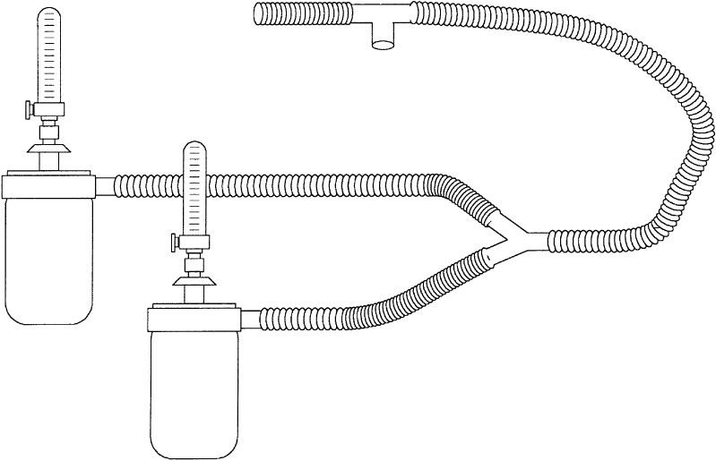
Oxygen Adders
Uses two flowmeters (one oxygen and one air) that blend two gases to obtain desired F_{i}o₂
F_{i}o₂ is determined using same ratios as air entrainment systems

Slide 69
Oxygen Blenders and Mixers
Mixes 50 psig source of oxygen and air to obtain precise F_{i}o_{2.}
Alarms signal failure of either compressed gas source.
Pressure change of 10 psig will activate alarm.

Slide 70
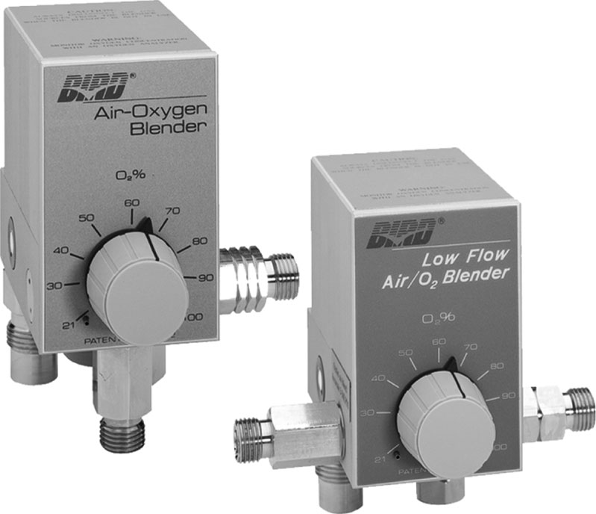
Oxygen Blender

Slide 71
Hyperbaric Oxygen Therapy
Increases the atmospheric pressure the patient is exposed to with either continuous or intermediate use of 100% oxygen
Clinical applications
  carbon monoxide poisoning
  smoke inhalation
  poor wound healing
  anaerobic infections
  thermal injuries
  skin grafts
  refractory osteomyelitis

Slide 72
Hyperbaric Oxygen Therapy (Cont.)
Physiologic effects
  Lung volumes: lung volumes decrease as pressure is increased (Boyle’s law)
  Alveolar and arterial partial pressure of oxygen: alveolar pressure will be increased as atmospheric pressure is increased; partial pressure of inspired gas will increase (Dalton’s law)
  Arterial partial pressure will increase as more oxygen is dissolved in the plasma (Henry’s law)

Slide 73
Hyperbaric Oxygen Therapy (Cont.)
Physiologic effects (Cont.)
  Gas temperature: kinetic activity of gases increases as gas pressure is increased; effects are minimized by regulation of rate of increase in pressure (Gay-Lussac's law).
  Work of breathing: as barometric pressure is increased, density of a gas will increase. This will increase work of breathing.
  Vascular function: enhances growth of new blood vessels; this effect is useful in the treatment of patients with skin grafts and poor wound healing.

Slide 74
Hyperbaric Oxygen Therapy (Cont.)
Physiologic effects (Cont.)
  Immunologic function: improved function of leukocytes during hyperbaric oxygen therapy; the therapy also inhibits growth of some types of bacteria.

Slide 75
Hyperbaric Oxygen Therapy (Cont.)
Monoplace chambers
  Large enough to hold one person
  Entire chamber is filled with pressurized oxygen.
Multiplace chamber
  Large enough to hold two or more patients
  There is usually an attendant.
  Chamber is filled with compressed air.
  Patient wears hood filled with oxygen.

Slide 76
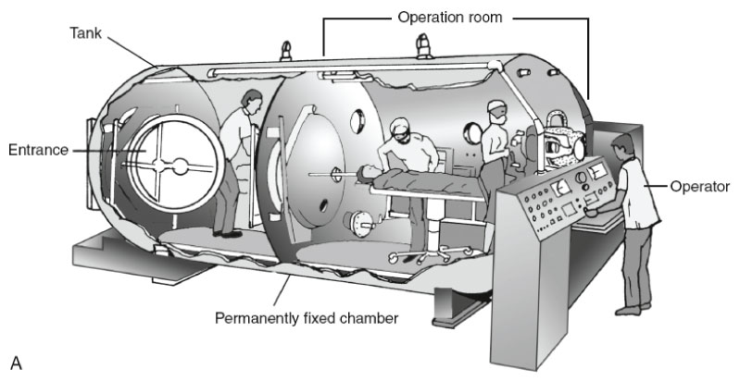
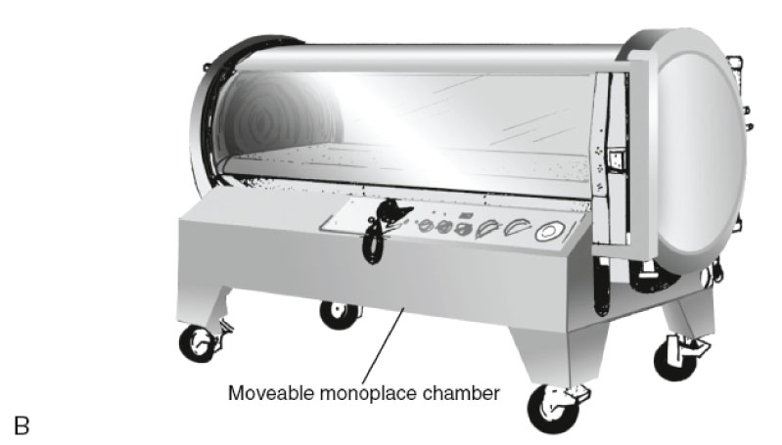
Hyperbaric Oxygen Therapy (Cont.)

Slide 77
Hyperbaric Oxygen Therapy (Cont.)
Monitoring devices
  Transcutaneous oxygen monitoring provides evaluation of perfusion.
  Arterial blood gas analysis can be done in chamber.

Slide 78
Indications for Hyperbaric
Oxygen Therapy
Air embolism
Carbon monoxide positioning
Cyanide poisoning
Decompression sickness
Gas gangrene
Refractory anaerobic infection
Refractory osteomyelitis
Skin grafts
Thermal burns
Wound healing

Slide 79
Contraindications for Hyperbaric Oxygen Therapy
Congenital spherocytosis
High fever
Hypercapnia (>60 torr)
Obstructive airway disease
Optic neuritis
Pneumothorax
Seizure disorders
Sinusitis
Upper respiratory tract infection
Viral infection

Slide 80
Nitric Oxide Therapy
Inhaled nitric oxide (iNO) has been shown to be a potent pulmonary vasodilator
Used to treat
  persistent pulmonary hypertension of the newborn.
  hypoxic respiratory failure in term and near-term newborns.
  an adjunct to the treatment of congenital cardiac defects.
  possibly to reverse the bronchoconstriction induced by histamine and methacholine.
Initial therapeutic dose is 5 to 80 parts per million

Slide 81
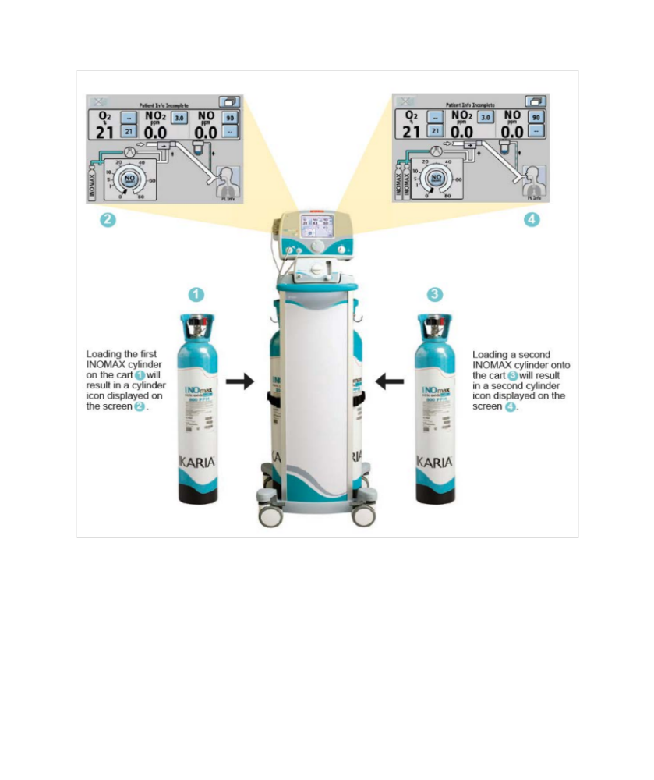
INOmax
Notes:
The INOmax gas monitoring system allows for continuous monitoring of inspired oxygen (O₂), nitrogen dioxide (NO₂), and NO. Several alarm systems are available to alert staff members when problems arise, including alarms for high and low NO, high NO₂, and high and low O₂. Other alarms can be set to notify the user when source gas pressure is lost, the electrochemical cells fail, and calibration is required.

Slide 82
Helium–Oxygen Therapy
Helium–oxygen (heliox)
Low density of gas improves ability of gas to move around obstruction.
Clinical application
  Exacerbation of asthma
  Treatment of postextubation stridor
  Treatment of refractory croup
  Treatment of severe airway obstruction in chronic bronchitis and emphysema

Slide 83
Helium–Oxygen Therapy (Cont.)
Available concentrations
  80% Helium and 20% oxygen
  70% Helium and 30% oxygen
  60% Helium and 40% oxygen

Slide 84
Helium–Oxygen Therapy (Cont.)
Can be administered through an endotracheal tube or well-fitted nonrebreather.
Actual flow: due to low density of gas oxygen flowmeters are not accurate.
Correction factors used to determine actual flow rate of gas:
  80:20—1.8 × liter flow
  70:30—1.6 × liter flow
  60:40—1.4 × liter flow

Slide 85
Carbon Dioxide (Carbogen) Therapy
Used to treat hiccups and carbon monoxide poisoning and in prevention of washout of CO₂ during cardiopulmonary bypass
Supplied as
  5% to 95% (carbon dioxide-to-oxygen)
  7% to 93% (carbon dioxide-to-oxygen)

Slide 86
Monitoring Carbon Dioxide Therapy
Blood pressure
Patient pulse
Respiration
Mental status
If decreases are observed, therapy should be stopped immediately.

